Slide 1
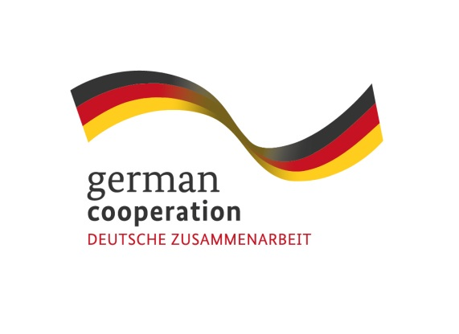
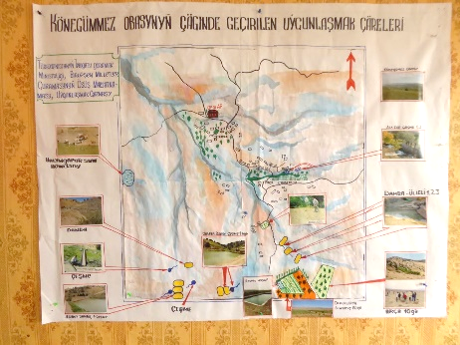
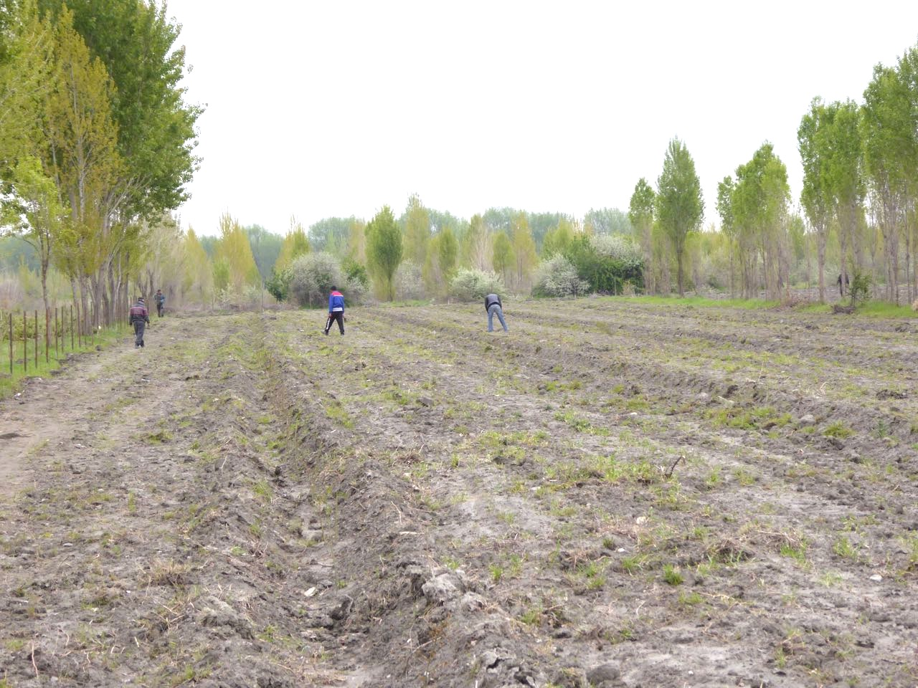
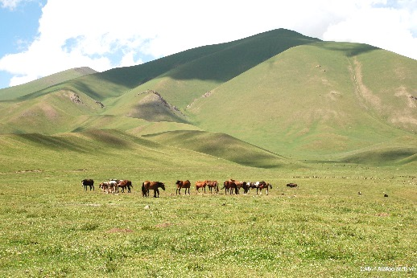
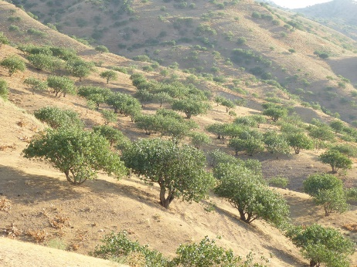
Proposal
Implemented by
“Developing a conceptual framework on integrated and sustainable land use management in Central Asia”

Slide 2
Introduction
Implemented by
Land Resources as pastures or forests present the production base for most of Central Asians inhabitants
Livestock keeping, production of agricultural crops, fruits, nuts and forest products constitute the main sources of income for rural populations.
The productivity of these natural resources is jeopardized by increasing land degradation, due to several reasons, as for example:
increasing population of livestock with subsequent overgrazing of pastures;
deforestation and poor management of forest resources;
increasing extreme climate events and other negative impacts related to Climate Change;
increased use of water for irrigation systems with subsequent salination of soils and competition for drinking water.

Slide 3
Challenges and prospects
Implemented by
In Central Asia there are numerous experiences on sustainable management of land resources - in particular on pastures, forests, orchards and arable crop-land.
These land resources are managed in immediate vicinity, with obvious trans-boundary impacts on each other, or are even interwoven in common land-use systems, as, for instance, pastures and forests.
In most cases, the lessons-learnt and experience of the interventions / approaches on land use end up not being used outside the interventions from which they emerged.
Although each Central Asian country has its specific context, nonetheless challenges for land use are very similar and call for regional learning, exchange and setting common frameworks.

Slide 4
Conceptual Framework
Implemented by
In order to make better use of the valuable experiences all over Central Asia, they should be organized in a conceptual and operational framework, which enables a wide-spread use of the conceptualized knowledge and is of particular use:
as a tool to create a common understanding and vision on integrated land use management
as a framework to develop sector policies: guiding principles, laws, by-laws, regulations for integrated land use management
as a framework to design new programmes: national sector programs, national and regional development programs (financed by donors)
as a framework for monitoring & evaluation of on-going programmes in a strategic way
as a knowledge management tool

Slide 5
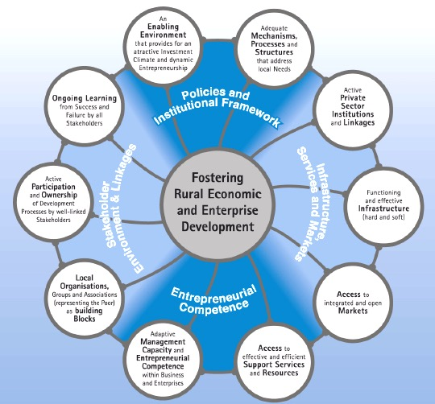
Example – Rural Economic & Enterprise Development
Implemented by

Slide 6
Proposal – how to develop Conceptual Framework
Implemented by
Embed the development of a conceptual framework on integrated and sustainable land use management in Central Asia within the REAP.
The conceptual framework will be built on the knowledge and experience base of CA stakeholders, who have implemented innovative land use approaches. The approach of developing the framework could be called “from practice to concept”, i.e. that the concepts being developed get their ideas and inputs from experiences gained in practice.
Initial workshop to create a common vision and understanding of what integrated and sustainable land use management means for Central Asia:
Exchange on different sustainable land use approaches from all Central Asian countries
Develop a common vision of what integrated and sustainable land use management means – develop the cornerstones of the conceptual framework

Slide 7
Proposal – how to develop Conceptual Framework cont.
Implemented by
Set-up working groups, composed of stakeholders from all CA countries, which will work on detailing conceptual framework
Presentation, discussion and final adaptation of the conceptual framework, based on the work done by the working groups; including public consultation.
Present the final version of the guide at an ICSD meeting, looking for official “approval” as a regional policy.
The process of developing the Conceptual Framework will be supported and facilitated by the regional GIZ programme on
“Sustainable and Climate Sensitive
Land Use for Economic Development in Central Asia” (SUSTAIN-CA)

